Slide 1
The BIG Wellbeing Quiz!

Slide 2
The RULES!
Welcome to our Skills to Go BIG quiz!
Listen carefully
Be respectful of others
Put your hand up to answer each question!

Slide 3
Section 1: Healthy and Happy!

Slide 4
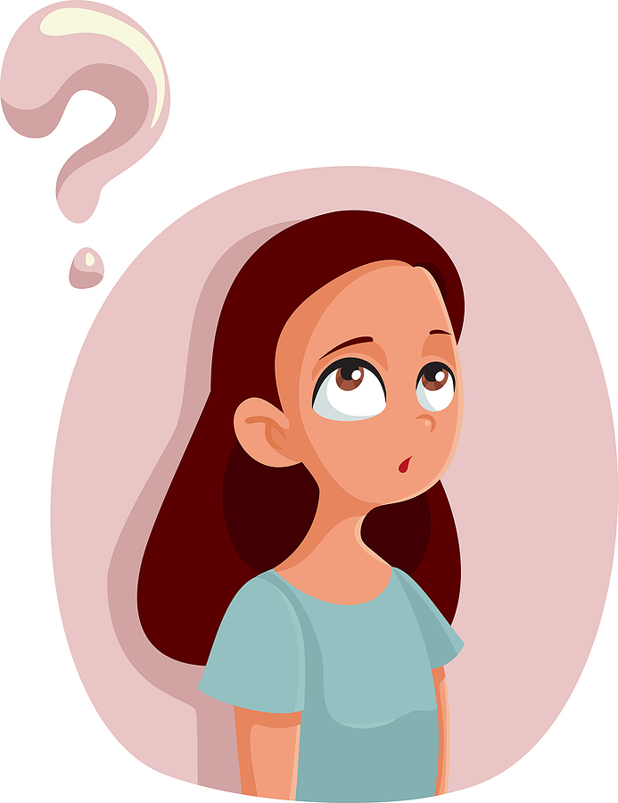
Question 1: Which of the following helps to look after our physical health?
Being active and feeling sad
Being active and eating healthily
Eating unhealthily and being inactive

Slide 5
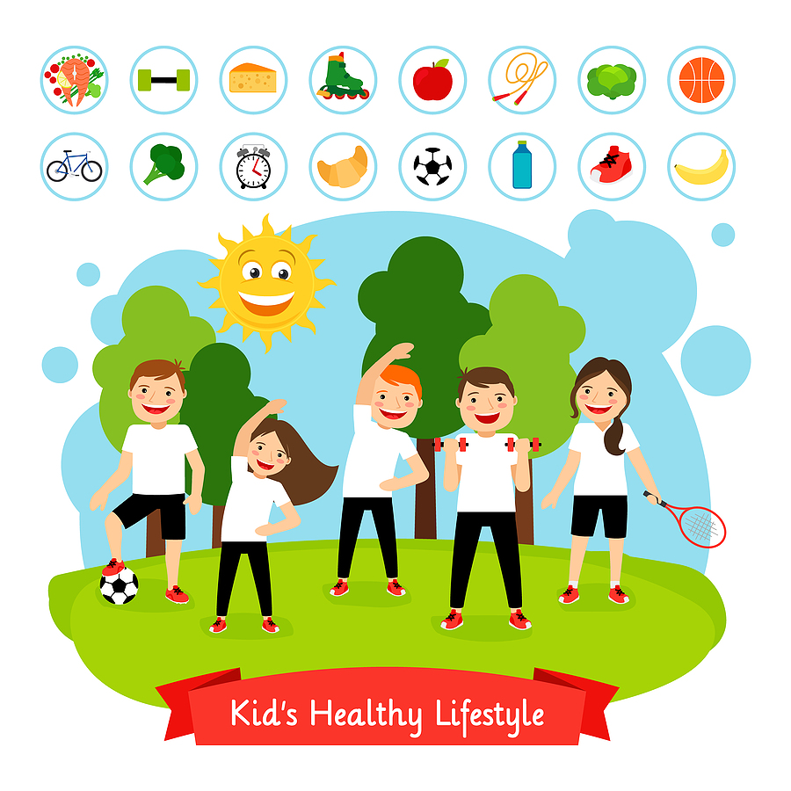
The answer is…
b. Being active and eating healthily
It’s important to fuel our bodies with healthy foods and keep active (walking, sports and exercise) to keep us fit and healthy

Slide 6
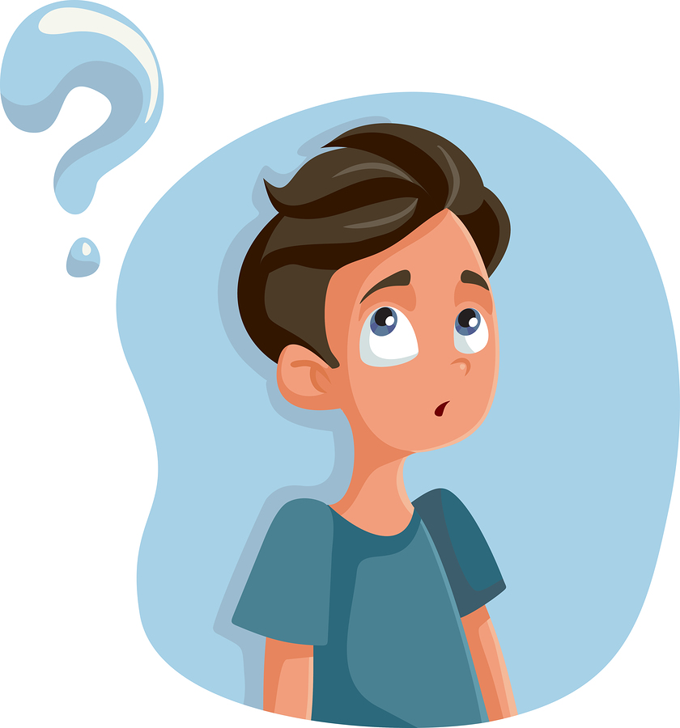
Question 2: What else helps keep us physically healthy?
Brushing our teeth
Washing our hands regularly
Getting enough sleep
All of the above

Slide 7
The answer is…
d. All of the above!
To keep physically healthy we need to brush our teeth twice a day (tooth decay is painful and can affect what we eat and make us feel quite poorly).
By washing our hands regularly (always before eating or after using the toilet!) we can help stop the spread of germs that can make us ill.
Sleep recharges our batteries (gives us energy to take on the day) and allows our body time to for growth and repair.

Slide 8
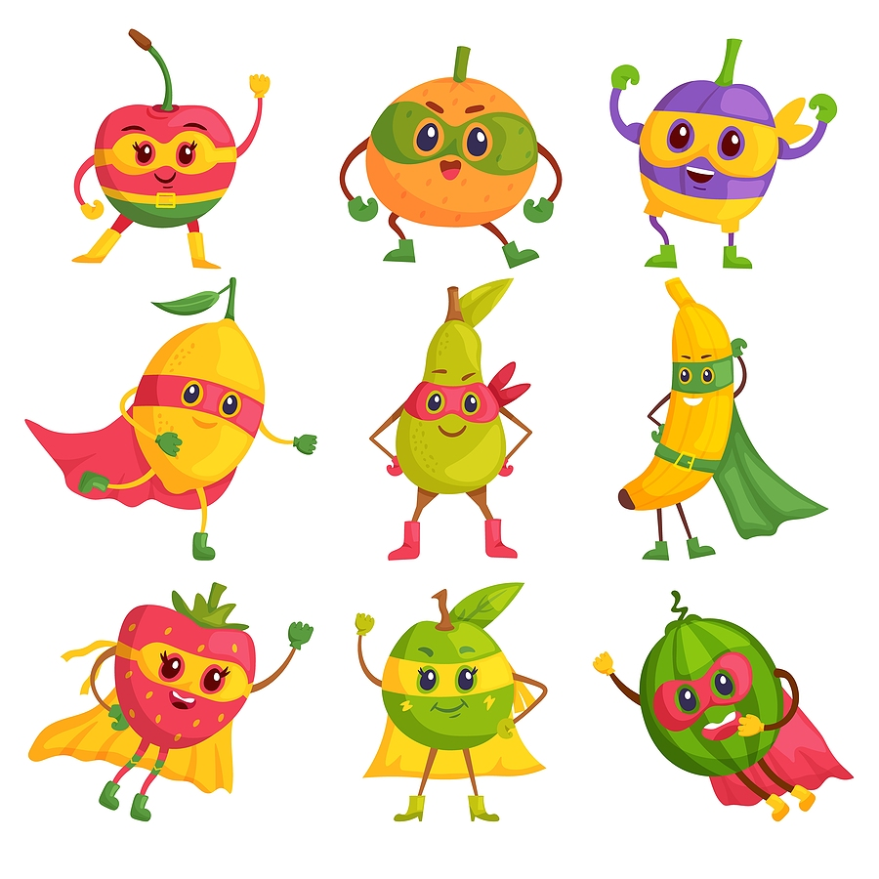
Question 3:To fuel our bodies we should eat a balanced diet. This means…?
Eating mostly healthy foods
Eating 5-a-day
Only having high sugar food occasionally
All of the above

Slide 9
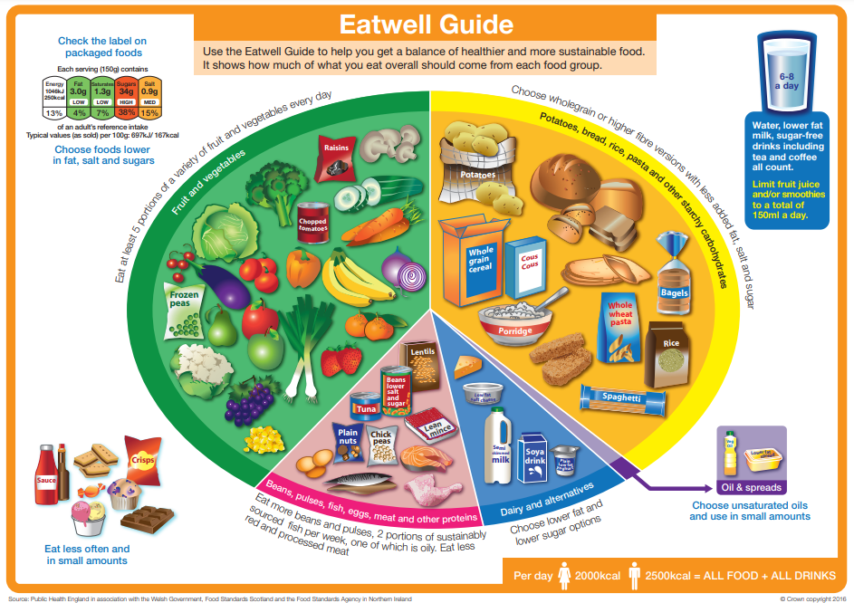
The answer is…
d. All of the above!
The Eatwell guide is a visual tool to help us eat a healthy balanced diet. This includes a variety of fruit and vegetables; starchy foods such as bread, rice and pasta; high protein foods such as meat, fish, eggs, beans and tofu; and finally diary foods (milk, cheese, yogurt or vegan alternatives)
Source:https://www.gov.uk/government/publications/the-eatwell-guide

Slide 10
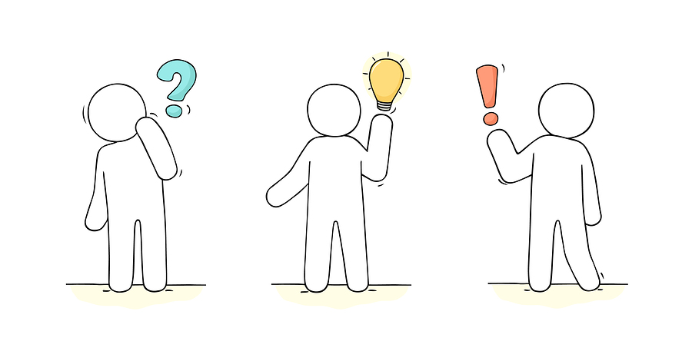
Question 4: mental health means…
How we think, feel and behave
How we exercise
How we do our homework
Not being poorly

Slide 11
The answer is…
How we think, feel and behave
Mental health includes our emotions (how we feel), how we think about things (how we cope and put things in perspective) and also our social wellbeing (connections through our friendships and family)

Slide 12
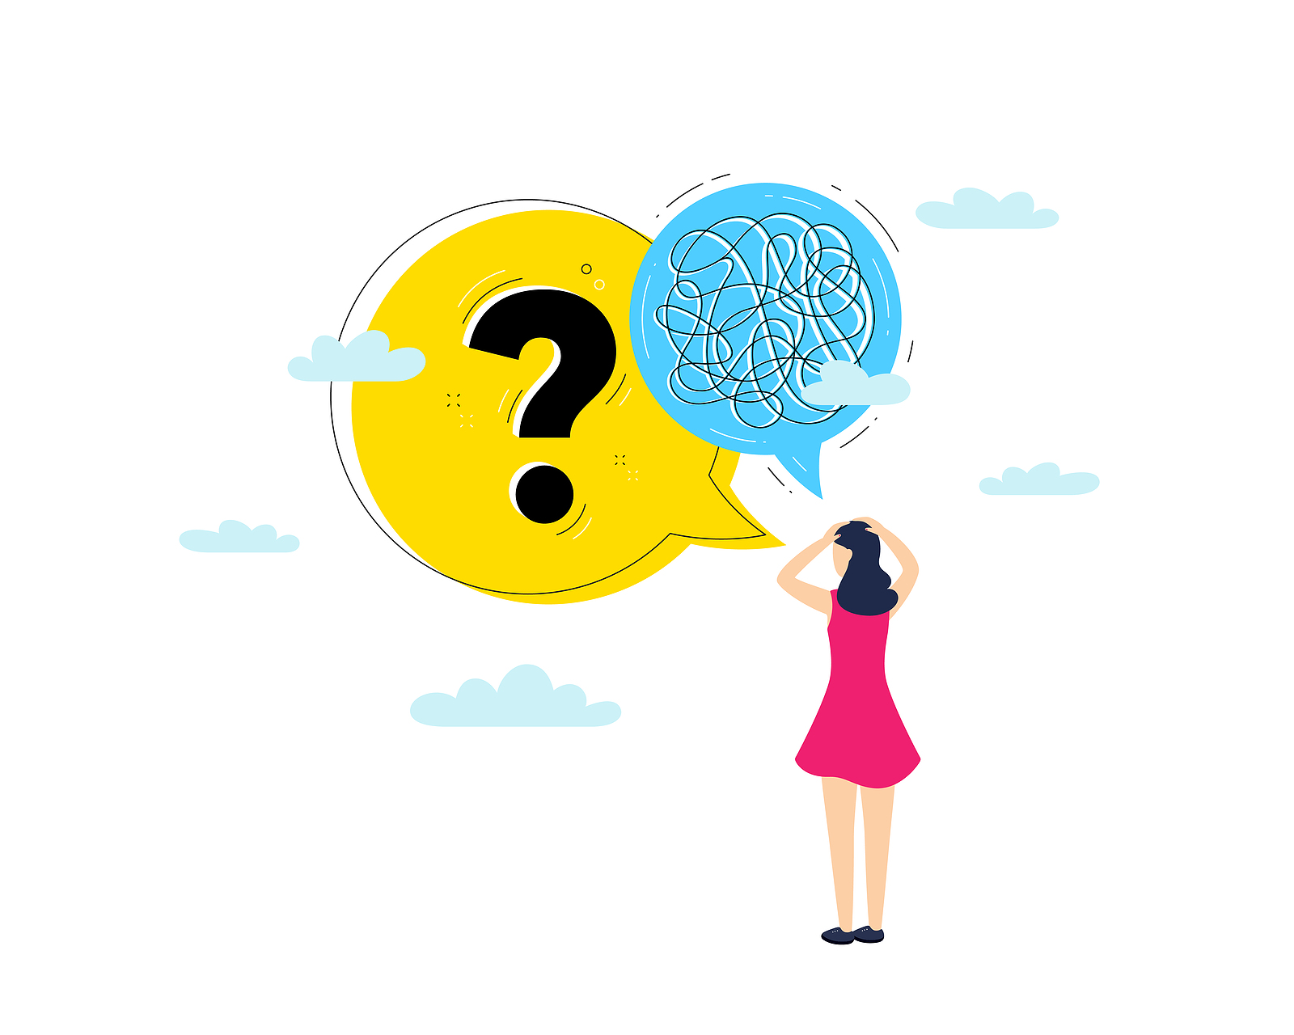
Question 5: We can look after our mental health by…
Feeling stressed
Taking on new situations
Using self-care
All of the above

Slide 13
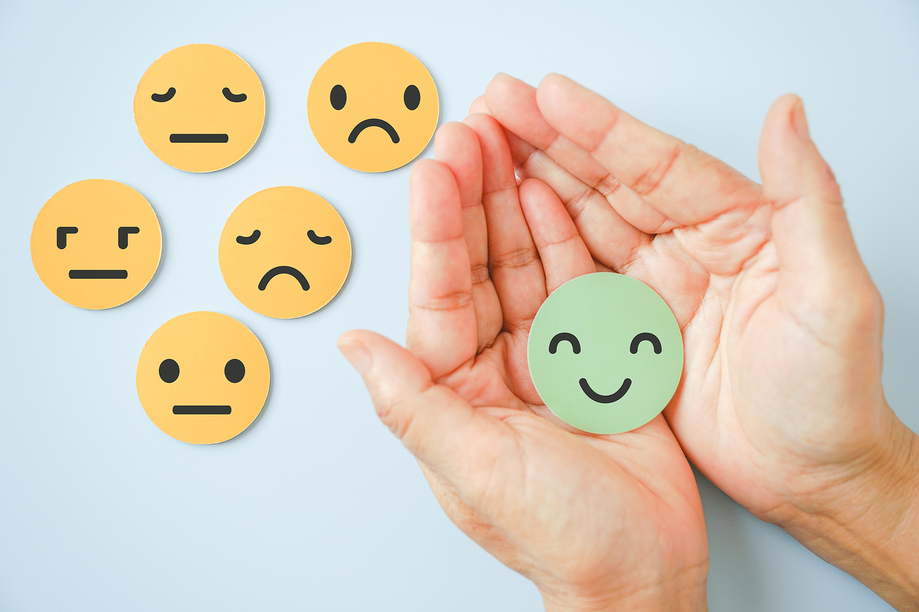
The answer is…
c. Using self-care
Self-care is how you look after YOU!
It includes both our physical and mental wellbeing.
It can be our hobbies, taking time to relax or talk to a friend, looking after a pet or having a bubble bath! Self-care is doing the things that help us relax and feel good about ourselves!

Slide 14
Section 2:
Sleep

Slide 15
FACT!
Did you know that getting one bad night's sleep can impact how you feel the next day?
Our next questions will help you to understand why sleep is so important and hopefully help you improve your night time routines and get a good night’s sleep.

Slide 16
True
False
Question 1: Children between the ages of 10 - 11 years need more than 8 hours sleep each night?

Slide 17
The Answer is...
a. True
You should be getting around 9 ½ hours sleep every night!
If you don’t get enough sleep, it can make you irritable, aggressive, upset and even tearful. Our immune system is not as good at fighting illness. Our bodies don’t heal and grow as well and information learned during the day isn’t stored properly in our memory

Slide 18
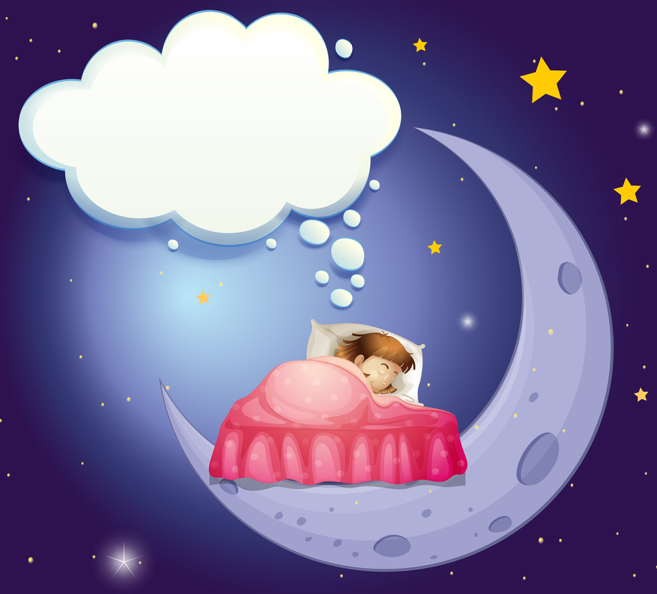
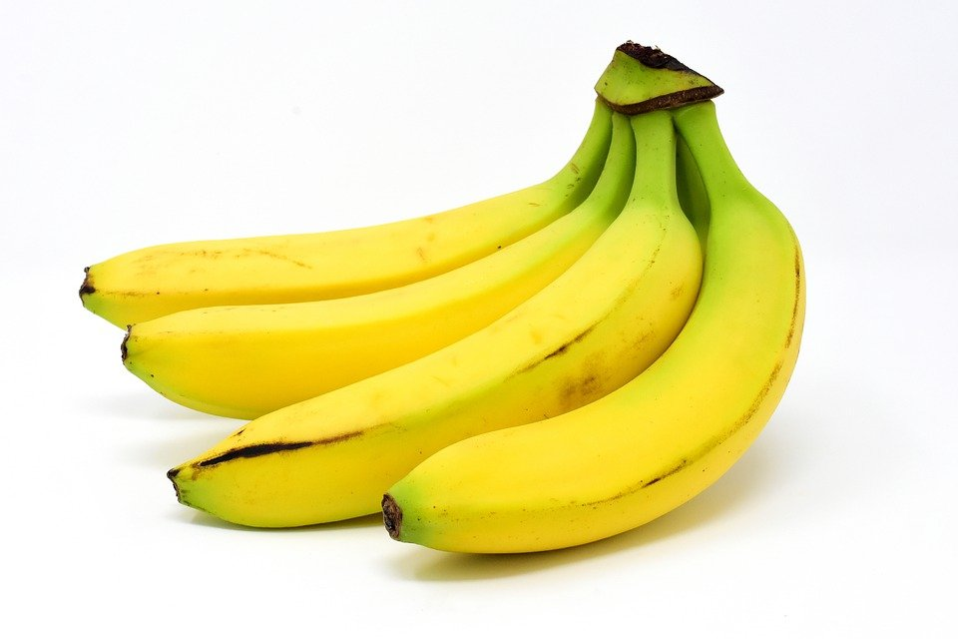
Question 2: Which of the following is a “sleepy food”?
Banana
Cheese
Almonds
All of them

Slide 19
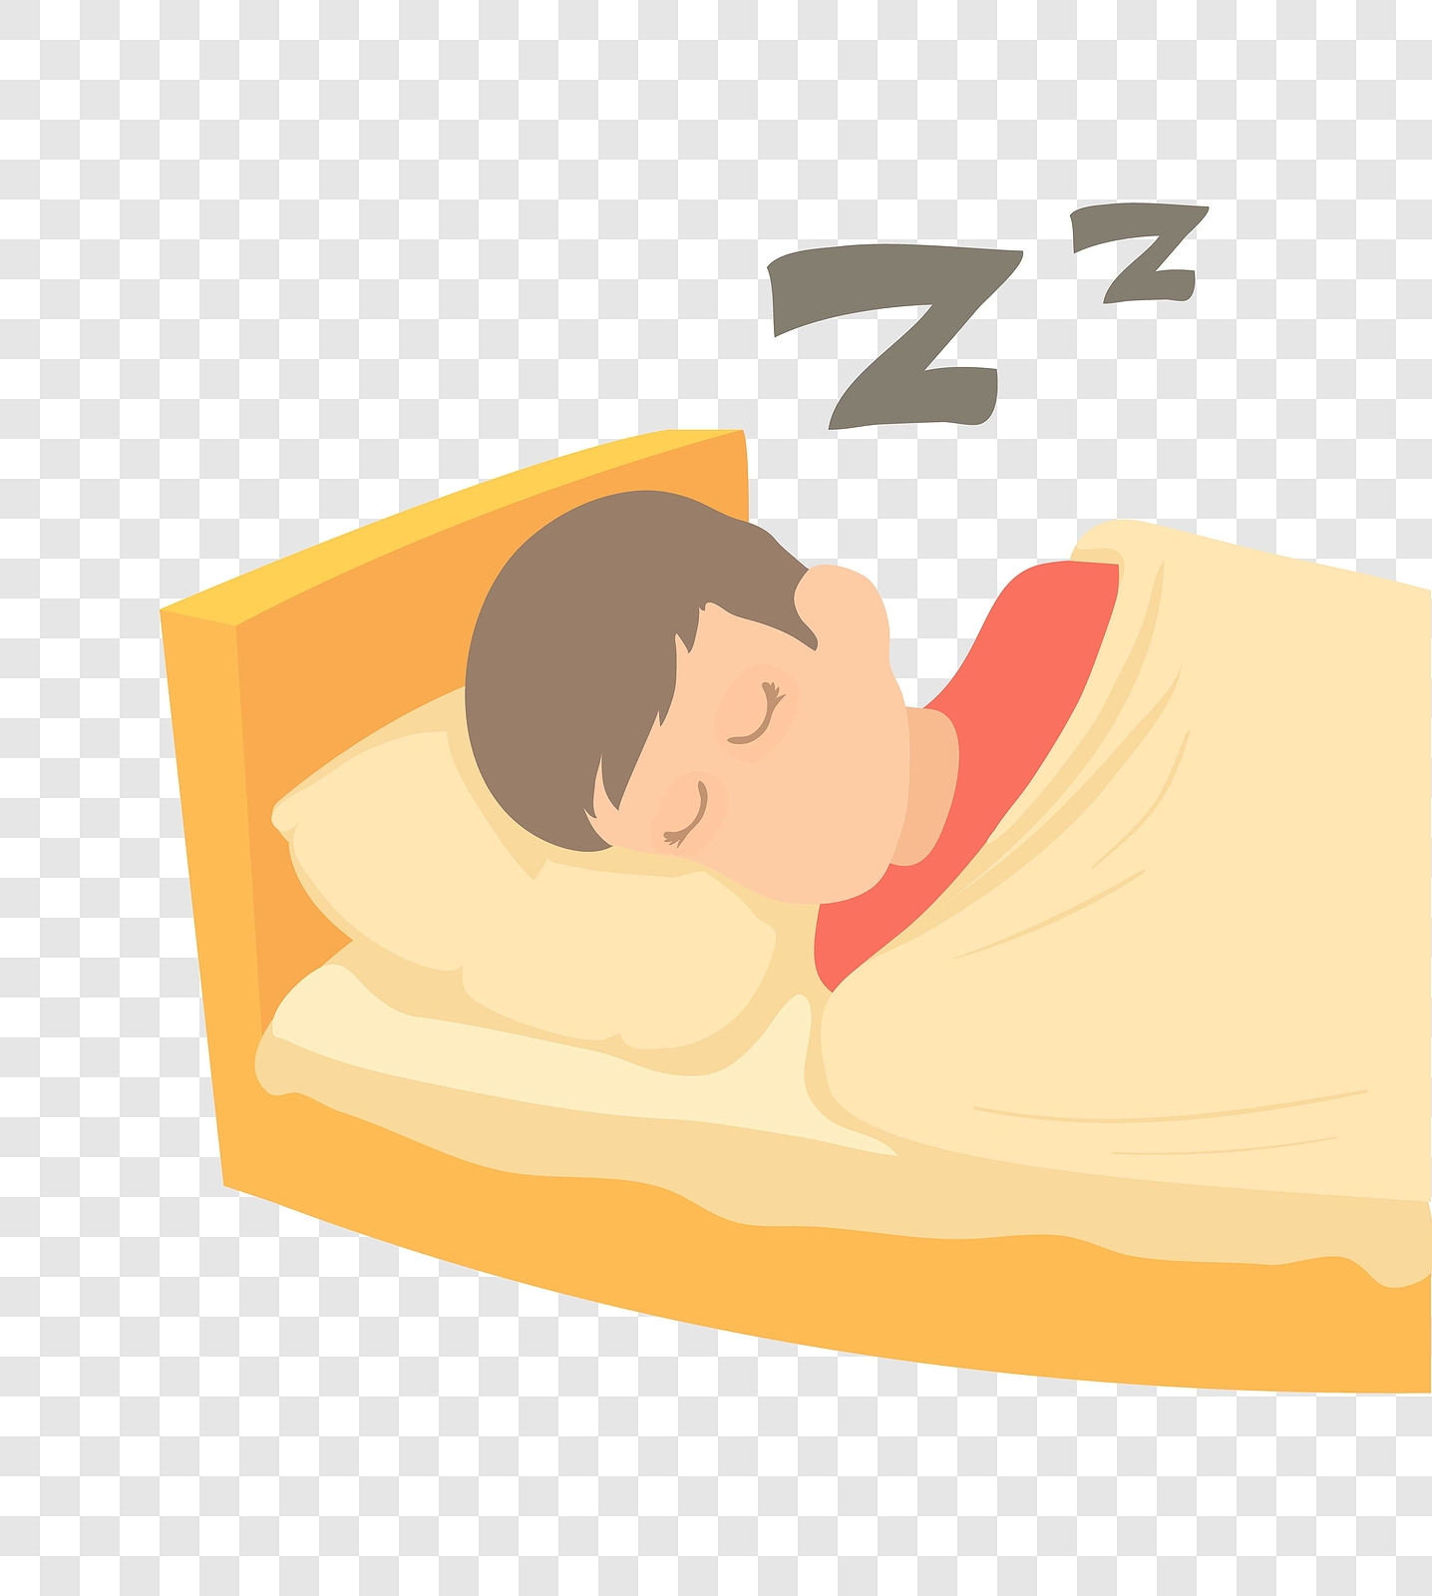
The Answer is...
d. all of them!
Bananas and cheese contain tryptophan, an amino acid (building block of protein) that helps us to nod off to sleep more easily.
Almonds contain magnesium, which promotes both sleep and muscle relaxation!

Slide 20
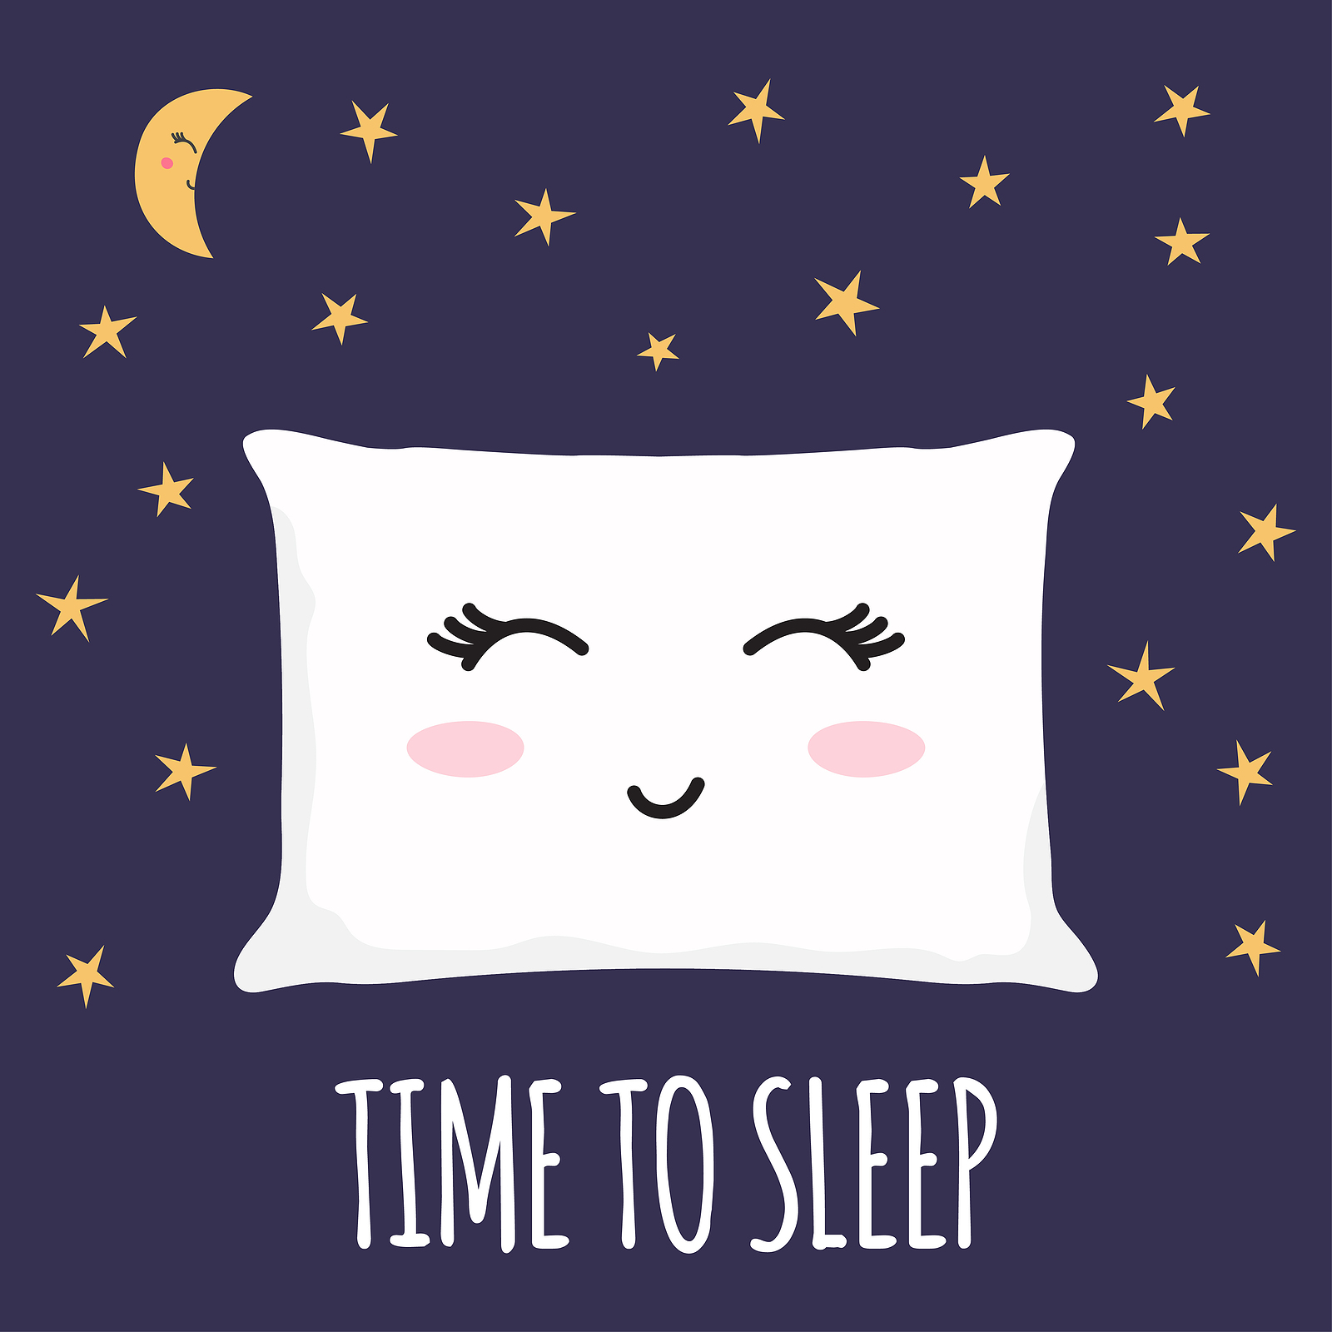
Question 3: Electronic screens should be turned off an hour before sleep?
True
False

Slide 21
The Answer is...
a. True
All screens, including TV, mobiles, laptop and ipads should be turned off an hour before bedtime!
Screen activities are mentally stimulating which may inhibit the production of the sleep hormone, Melatonin.

Slide 22
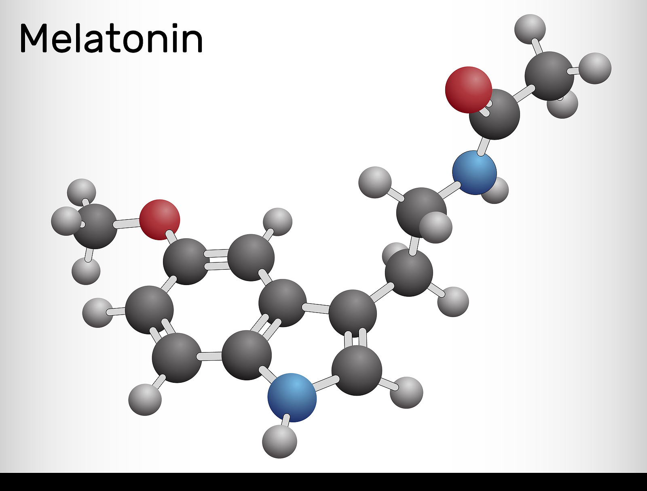
Question 4: Melatonin is sometimes known as “the hormone of darkness”
True
False

Slide 23
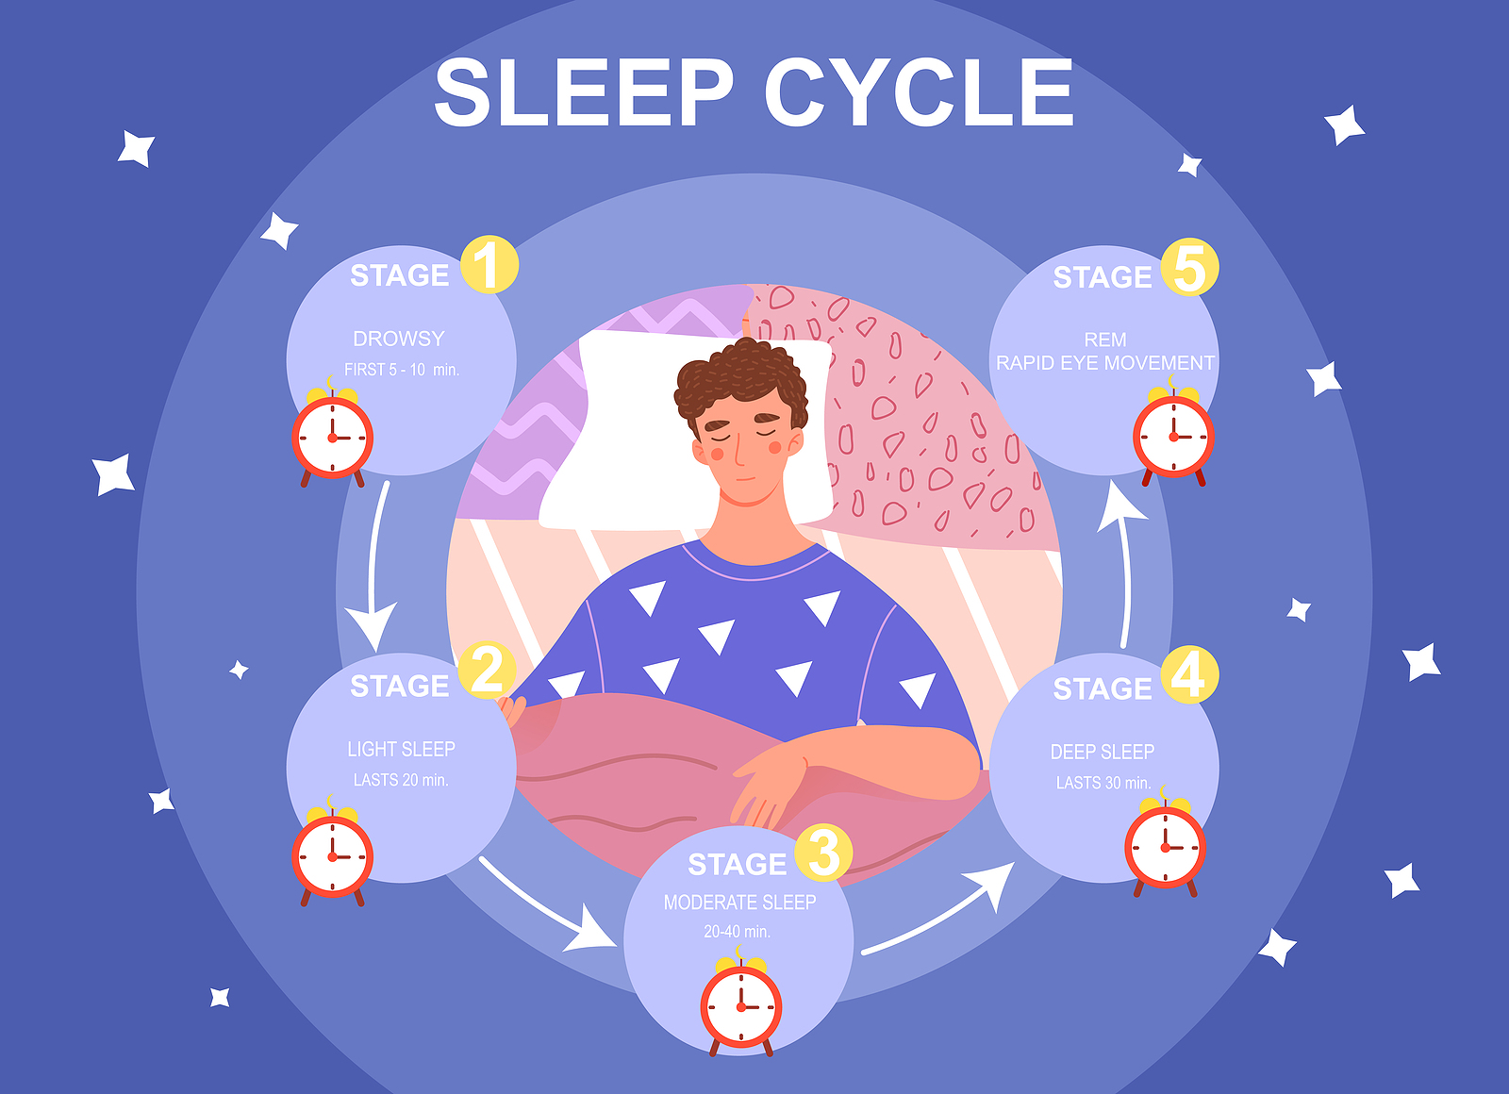
The Answer is...
a. True
Melatonin is a naturally occurring hormone that’s produced by the brain and it plays an important role in promoting restful sleep.
Levels of Melatonin rise at night making you feel sleepy and reduce at dawn causing you to wake.
This is why it’s known as “the hormone of darkness”

Slide 24
Top Tips For Healthy Sleep

Slide 25
Section 3: Resilience and having a positive mindset

Slide 26
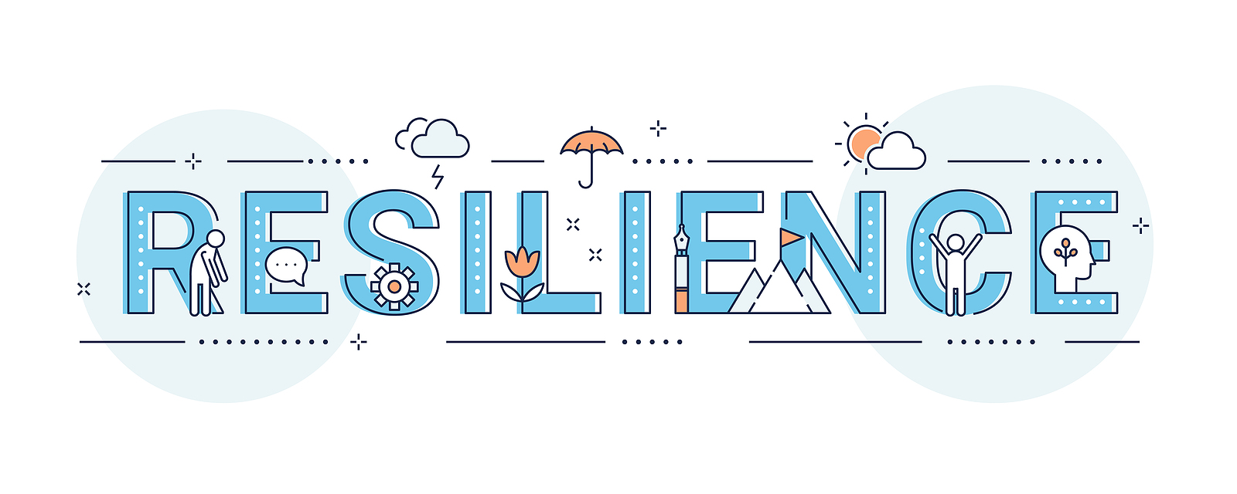
Question 1: Resilience is your ability to....
Bounce back from difficulty
Be good at everything
Be be outgoing and confident all the time
Not feel stressed or worried

Slide 27
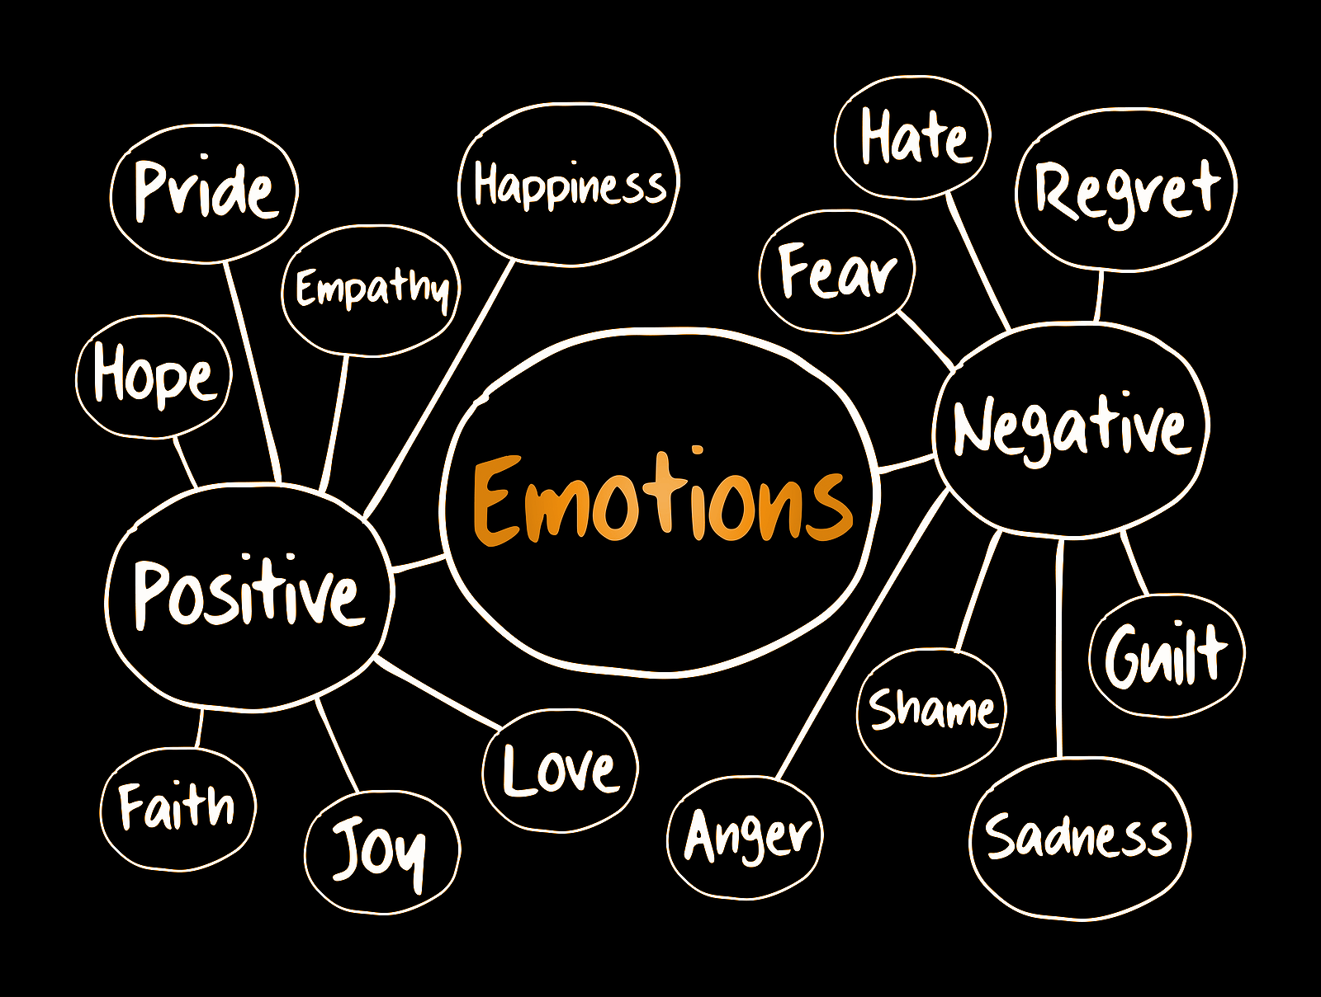
The answer is…
a. Your ability to bounce back
Some people think that resilient people don’t suffer stress, anxiety and emotional upset.
This isn’t the case - we all experience positive and negative situations and emotions.
Resilience is about HOW you work through that problem or difficulty and how you MOVE ON from it

Slide 28
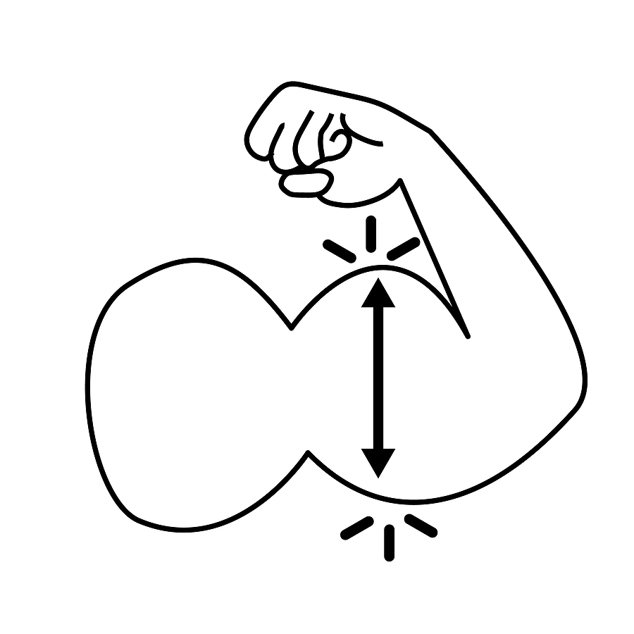
Question 2: Resilience can be trained like a muscle?
True or False

Slide 29
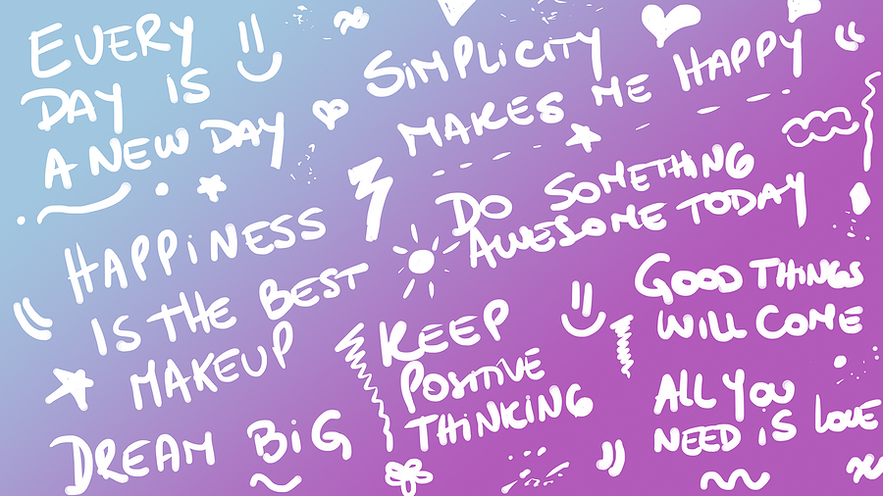
The answer is…
True!
Resilience isn’t something we’re born with, we build and develop resilience throughout our lives.
Resilience is like a muscle if we train it - it will get stronger.

Slide 30
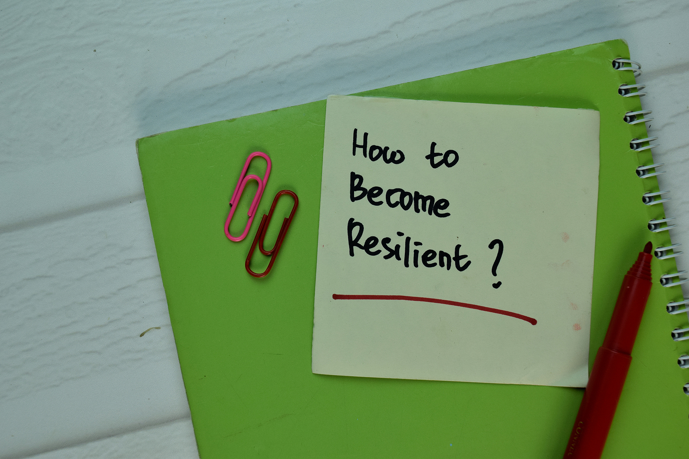
Question 3: Which of the following helps grow a positive mindset?
Giving up when things get tricky
Not trying your best
Learning from mistakes

Slide 31
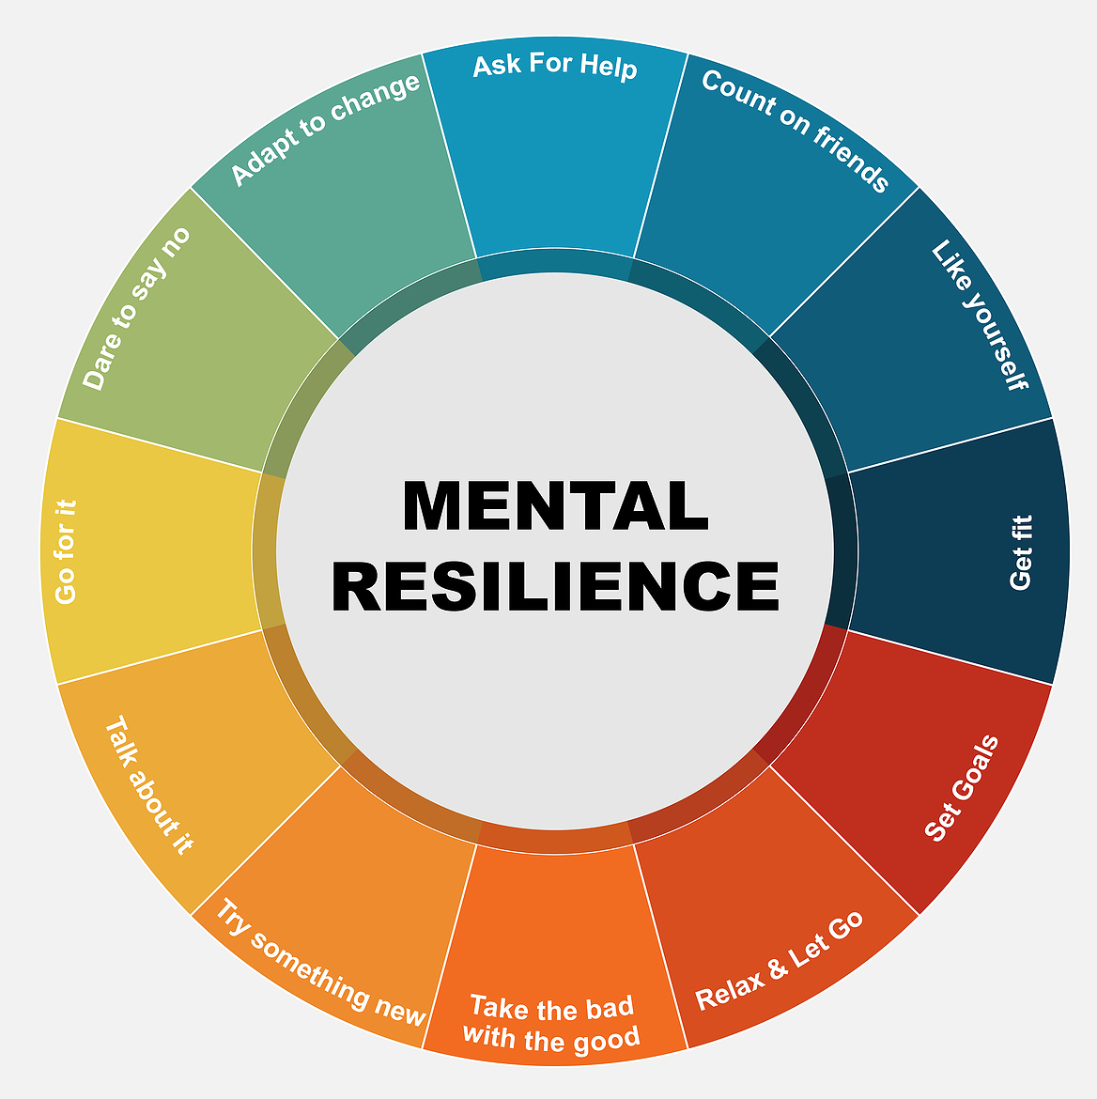
The answer is…
C. learning from mistakes
Having a positive mindset means that every situation helps us learn and grow. Things may seem difficult at first, but we can learn from mistakes or things that didn’t work so well, and use these skills in the future.
People who have good levels of resilience are SELF-AWARE and they take care of themselves

Slide 32
Question 4: What can you do yourself to reduce feelings of worry and anxiety?
a. Look for ways to adapt, be flexible and starting a new routine to feel more productive.
b. Remind yourself to take time to do the things you like!
c. Continue to make plans and set goals, no matter how small.
d. All of the above

Slide 33
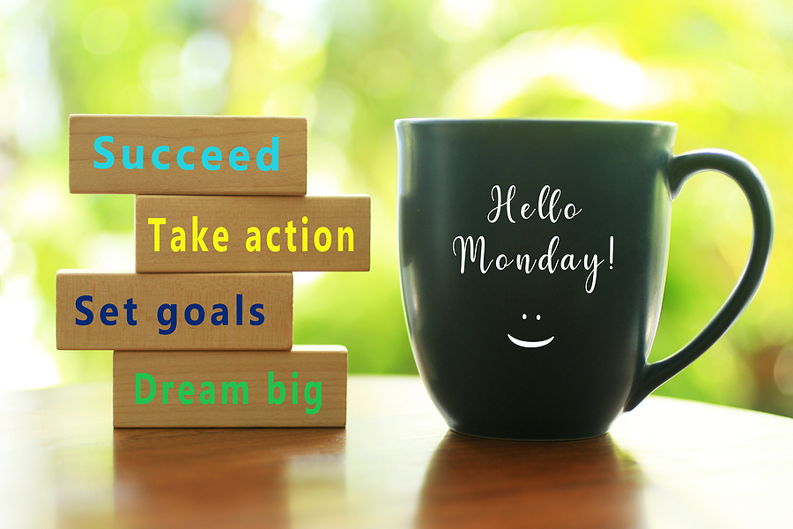
The Answer is...
Remember to:
Allow yourself time to adjust to any changes
Focus on the things you can do, as well as being aware of what you can’t
Stop yourself if you notice that you’re getting carried away with “what if’s” or worrying!
Be kind to yourself: make time each day to do something you enjoy
Friendships are important, connect with others
Access further support if you require it
d. All of the above
Having the attitude of “Keep it positive, Keep it simple!” can be really helpful in taking back control if you are feeling anxious.

Slide 34
How did you do?
0-5 = Skills to Go BIG (Noobie!)
6-10 = Skills To Go BIG (Level-up!)
11-14 = Skills to Go BIG (Pro!)

