Slide 1
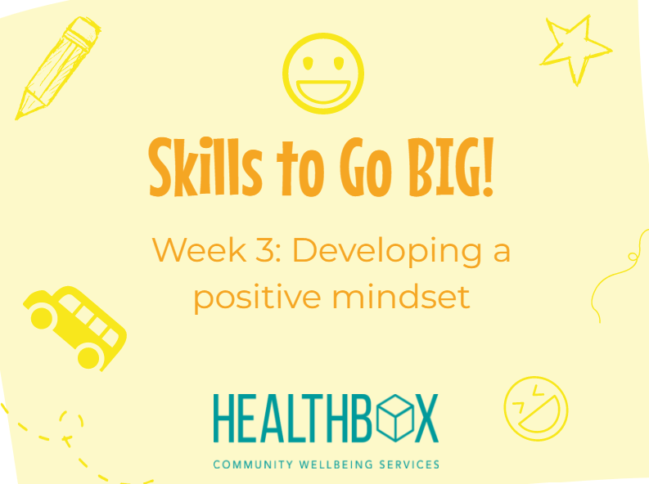

Slide 2
Thinking about types of feelings
Some we recognise as positive
Some we associate with being more negative
All feelings are important
Recognising what we are feeling and understanding why we feel like we do is the first step to being able to regulate (control) how we react and how we behave
Notes:
Over the last 2 weeks we have focused on recognising our feelings and emotions and how to look after both our physical and emotional wellbeing.
We all experience many different emotions and we recognise some as more positive than others.

Slide 3
What is a positive mindset?
Recognise something difficult as a challenge and rise to this rather than feel defeated or upset
Try your best but know we don’t always get everything right first time!
You know when to ask for help!
You learn from mistakes as see this as a chance to improve
Its HOW you work through a problem or difficulty and how you MOVE ON from it
Notes:
Today we are going to think about developing a positive mindset. This is a skill often referred to as RESILIENCE. Resilience is our ability to cope with a difficult or challenging situation in a positive way or put more simply our ability to bounce back!
Resilience helps us stay positive – this in turn helps our emotional wellbeing.

Slide 4
Class Activity 1: Building our skills
You have been given a piece of homework that you don’t understand how to complete…
How do you feel?
What could you do?
Who could you ask?
What might happen if you didn’t ask for help?
Notes:
Have a think about this situation. Imagine you have some homework, but you don’t understand what you need to do. How are feeling – write down positive and negative feelings. Which of these are more helpful and will help you solve the problem? How can using a positive mindset help you overcome difficulties? By asking for help (having confidence and being honest) I can get the support I need to complete my homework to my best ability.

Slide 5
Growing a positive mindset
One way to develop resilience is to remember we ALL have skills!
Resilience is like a muscle
If we train it – it will get stronger!
These might be different to your best friend or siblings – we are all different, but we all have our own interests and abilities
We all learn in different ways, but this is also fine!
Not comparing yourself to others is important – we are all on our own journey
We develop skills to cope with challenges as we go through life – we can think of this as a skills toolkit
Notes:
Resilience isn’t something we are born with, but it is something we can build and grow during our lives. Thinking of resilience as a muscle is a good analogy as the more we practice these skills and using a positive mindset the better we can cope with change, difficulties or challenging situations.

Slide 6
Positivity Toolkit!
What helped me?
What didn’t help?
Who did I speak to or ask for advice?
What did I learn?
What would I do if this happened again?
How can I stop this happening again?
Notes:
Each time we face a challenge we LEARN from it – what went well and what didn’t help? We can put the helpful things in our skills toolkit! Think back to helping the child who didn’t understand his homework – what would we put in our toolkit from this situation?

Slide 7
Class Activity 2: Building self-confidence and self-awareness
Make a list of positive statements about yourself
Think about the activities you enjoy and the skills you have…
This could be that you love football
That you are a very good friend
Your have gymnastic awards or do Jiu Jitsu
You are a good listener or always try you best in school
You are a Lego master builder or have Minecraft hero skills!
You play the piano or guitar
This is about YOU – your skills and your strengths!
Notes:
One of the fist ways to start building a positive mindset is to think about what YOU are good at! What makes you special and what you enjoy doing. Have a go on your own or with a partner to make a self-esteem tower and compete the my skills worksheet.

Slide 8
Positive affirmations!
I sometimes feel angry…
But I can CALM down!
Sometimes I get things wrong…
But I LEARN from mistakes!
Today made me sad…
But I am LOVED and IMPORTANT!
I can be shy…
But I can also be BRAVE!
Sometimes I find school hard…
But I CAN DO hard things!
I might not always understand first time…
But I love to LEARN!
Today didn’t go so well…
But tomorrow will be BETTER!
Notes:
The last thing we are going to think about in this session is balance and that we can use positive thinking to meet challenges! Have a think about the following statements, they may start with a slightly negative thought, but we can use our positive mindset to balance this!
I can be shy…but I can also be brave or courageous
I can sometimes find school work difficult…but I can do hard things.
I might not always understand first time…but I love to learn
Today didn’t go so well… but tomorrow will be better.
Extension activity: Can the children think of any positive affirmations of their own?

Slide 9
What’s in your Skills to Go BIG! Toolkit?
I know change can be worrying and exciting at the same time – but I am ready!
Self-care skills – to keep me happy and healthy
I can use a positive mindset to help me learn and grow and cope with new challenges
I can recognise my emotions and feelings – this will help me regulate how I react to new situations
Notes:
Can the children add anything extra to this? We will keep adding skills in the next sessions.

